Slide 1
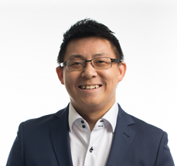
About Me
Director, Corporate Strategy
Sears Canada
Director, Merchandising
Menswear, Basics, Target Canada
Director, Commercial &
Featuring Planning, Walmart Canada
2015
2010
2016
2008
2021 - Current
General Manager
Markwise Plastics Inc
Divisional Merchandise Manager
Menswear, Sears Canada
2012
Product Management
Grainger Canada
Arthur Ma
Founder & CEO
Wingmen Suits Inc.
(Side Hustle)
EDUCATION
KEY SKILLSETS
RETAIL EXPERIENCE
INTERESTS
Hons. B.A. Economics
University of Toronto
Strategic Thinker
Walmart Canada
Spending time with family
MBA, Queen’s (Smith)
School of Business
Solutions Oriented Problem Solver
Target Canada
Entrepreneurship
Collaborator &
Servant Leader
Sears Canada
Loves to travel
Loblaws Companies
Basketball, Golf, F1

